Slide 1

Image Classification of Cats and Dogs using CNN
SRI RAM SHARMA

Slide 2
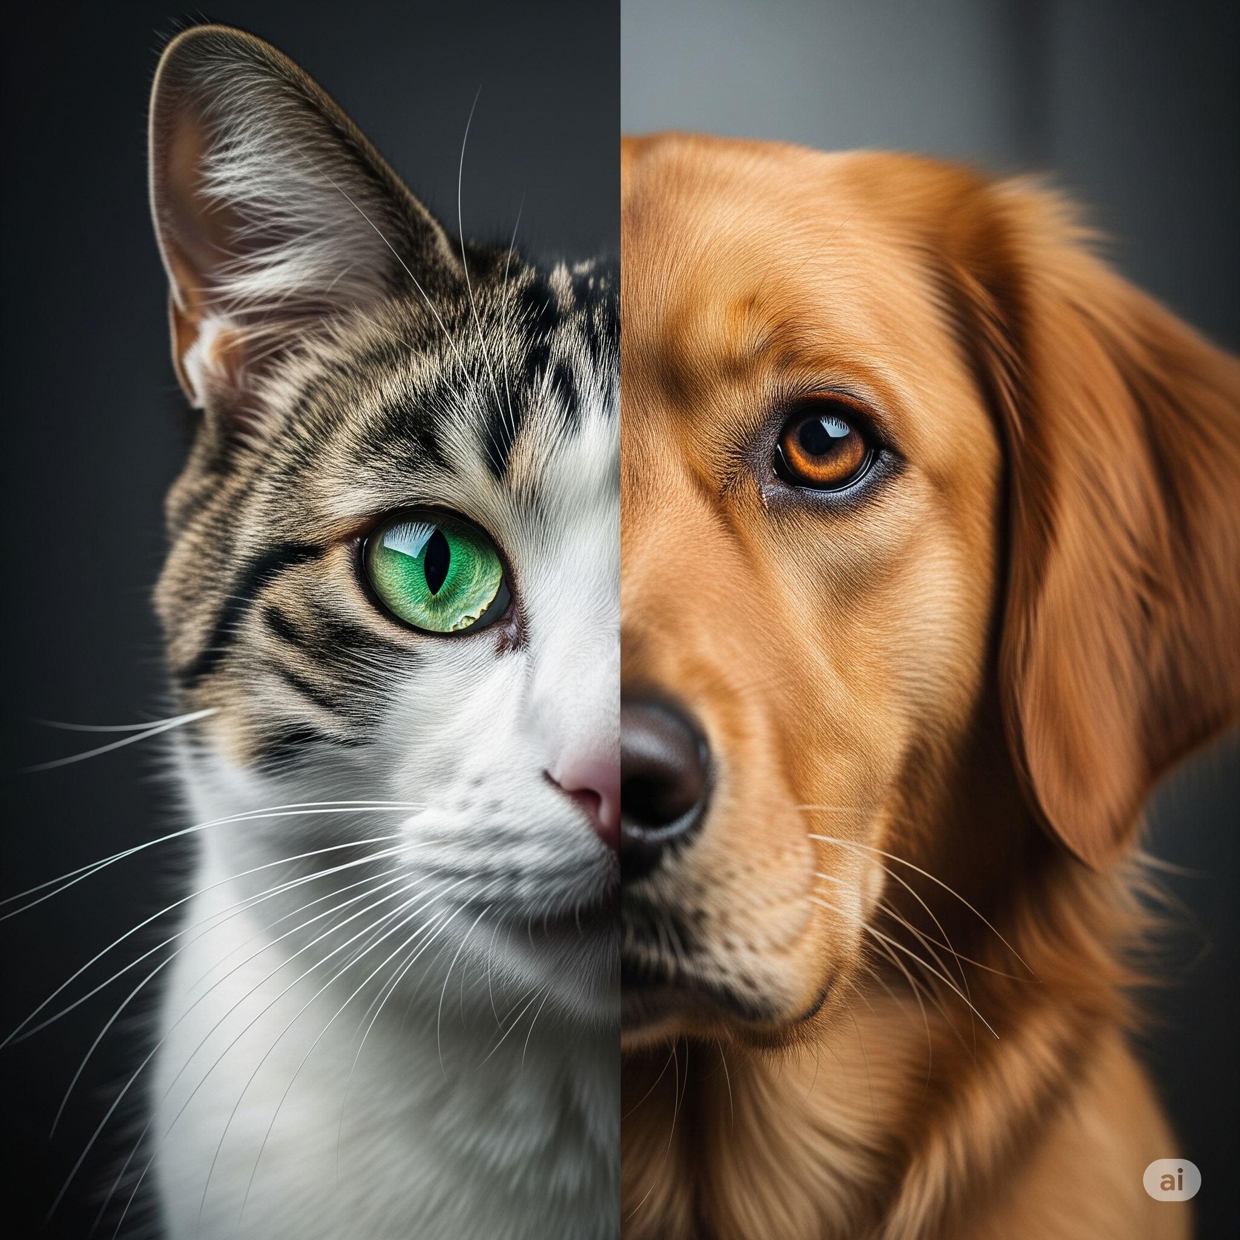
PROBLEM STATEMENT
Challenge:
Automatic image classification between two animal species.
Applications:
Pet identification apps, veterinary systems, social media auto-tagging.
Why CNN?
A CNN is a deep learning model especially effective for image data, though also used for video, audio and other grid-like data.

Slide 3
DATASET OVERVIEW
DATASET
Binary Classification
Source: Microsoft Kaggle Cats and Dogs Dataset.
Size: ~25,000 high-resolution images.
Classes: Binary classification (Cats vs Dogs).
Data Split: 70% Training, 15% Validation, 15% Testing.
Preprocessing: Image validation, corruption removal, resizing to 150x150.
CATS
DOGS
70% - TRAINING
15% - VALIDATION
15% - TESTING

Slide 4
DATA PREPROCESSING AND AUGUMENTATION
Image Normalization: Pixel values scaled to [0,1] range.
Data Augmentation Techniques:
Rotation : (40°)
Width/Height shifts : (20%)
Shear, Zoom Range : (20%)
Horizontal flip
Fill Mode : Nearest
Purpose: Increase dataset diversity, prevent overfitting.
Batch Size: 64 images per batch for optimal training.

Slide 5
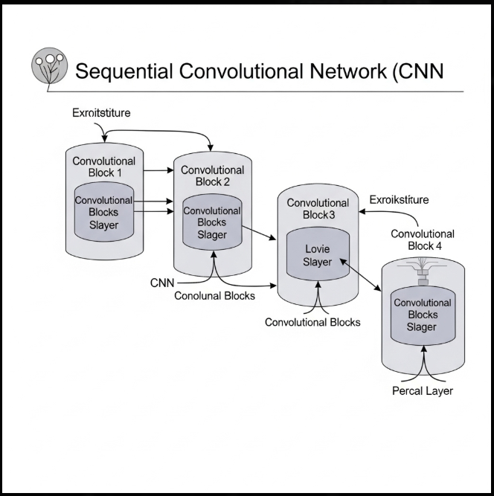
CNN - ARCHITECTURE MODEL
Model Type: Sequential CNN with 4 convolutional blocks.
Deep Architecture Benefits: Enhanced feature extraction capability.
Key Components:
4 Conv2D blocks with progressive filter increase
MaxPooling2D for dimensionality reduction
Batch Normalization for stable training
Strategic Dropout layers for regularization
Output: Single neuron with sigmoid activation (binary classification)

Slide 6
MODEL TRAINING & Validation STRATEGY
Training Duration: 32 epochs for optimal convergence
Optimizer: Adam with adaptive learning rate
Loss Function: Binary cross entropy.
Training Enhancements:
Early Stopping (patience=5)
Model Checkpointing (save best weights)
Learning Rate Reduction on plateau
Training Resolution: Leveraging 150×150 input for detailed learning
Model Convergence: Optimal training duration achieved in 32 epochs.

Slide 7
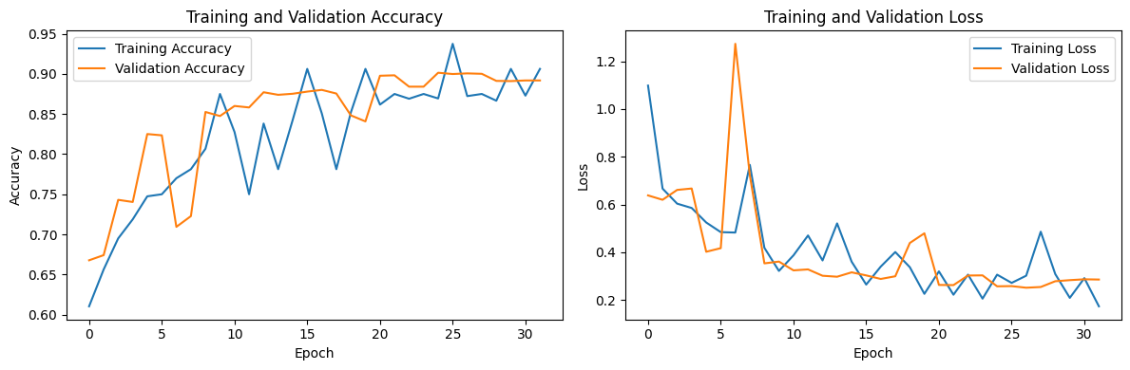
Training Visualization Loss and accuracy curves over 32 epochs.
Test Accuracy: 0.8998
Test Loss: 0.2442

Slide 8
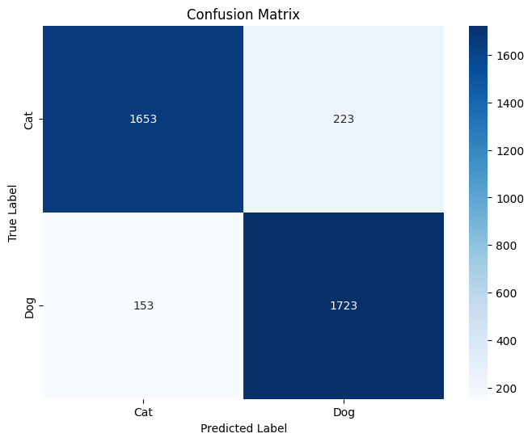
TRAINING RESULTS CONFUSION MATRIX & CLASSIFICATION REPORT
CLASSIFICATION REPORT
 | Precision | Recall | f1-score | support
Cat | 0.92 | 0.88 | 0.90 | 1876
Dog | 0.89 | 0.92 | 0.90 | 1876
Accuracy |  |  | 0.90 | 3752
Macro Avg | 0.90 | 0.90 | 0.90 | 3752
Weighted Avg | 0.90 | 0.90 | 0.90 | 3752

Slide 9
LIMITATIONS & FUTURE WORKS
FUTURE WORKS :
Expand Dataset: Incorporate more diverse images and additional animal classes.
Model Improvements: Experiment with deeper architectures or advanced techniques (e.g., transfer learning with pre-trained models).
Deployment: Can be deployed on more powerful platforms for better performance and capabilities.
Explainability: Integrate tools like Grad-CAM to visualize model decision-making.
Robustness: Test and improve model performance on challenging or adversarial images.
LIMITATIONS :
GPU Dependent : Needs GPU for increased performance.
Lack of complex dataset.
Average Image Resolution : Used due to lack of GPU processing power

Slide 10
CONCLUSION
This project successfully demonstrates the power of CNNs for image classification. The IBM SkillBuild Internship provided invaluable experience in practical AI development.
Summary: Developed a CNN model with 89.98% accuracy for cat/dog classification.
Learning Outcome: Gained hands-on experience with TensorFlow, Keras, and CNN architecture design.
Github Repository : Image Classification of Cats and Dogs using CNN
Colab Notebook : cats_and_dogs_CNN.ipynb

